Slide 1
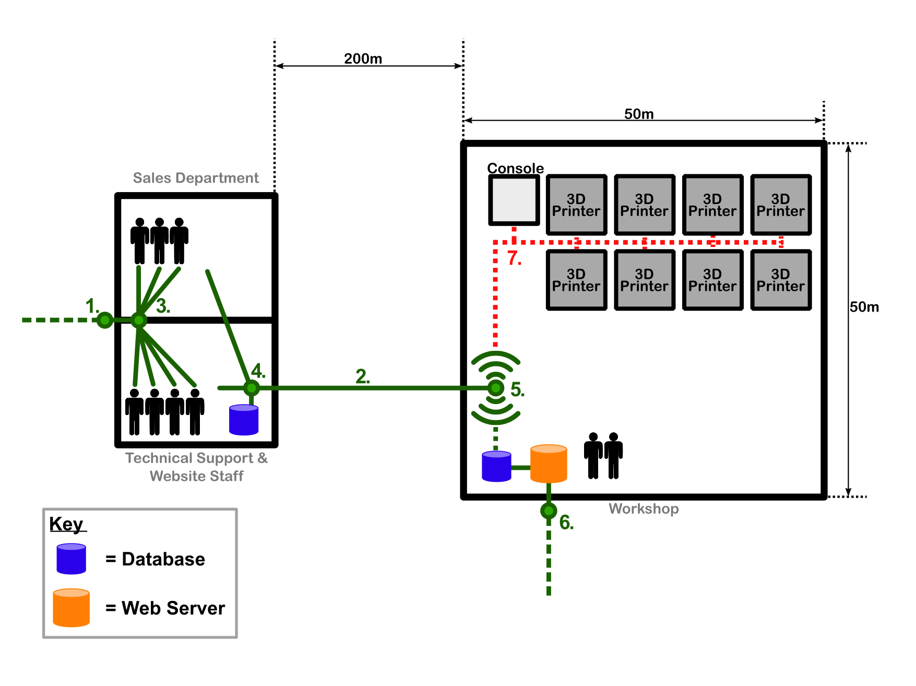
Point 7
Point 7 manages the connection of the 3D Printer network and its connection to business network.
Main Considerations are connection speed, reliability, security and cost.
Majority of 3D printer technologies (FDM, SLA) connect via USB or Wi-fi.

Slide 2
Possible Solutions
Wired
USB Hub, USB 2.0/3.0 Cabling
Automatic Printer Switch (Ethernet), USB to Ethernet Adapter
Wireless
Router
Wireless Hub
Repeater

Slide 3
Advantages
Wired Connection is much more secure and reliable.
Wired networks offer more speed than wireless.
Easier mobility of network and devices with Wireless.
USB to Ethernet adapter data rates as fast as 1000Mbps.
Disadvantages
Installing a physical link of USB and hub is more costly than a wireless setup
More cables around the warehouse for wired connection increases risk hazards in the work place.
Specifically designed printer network switches require an Ethernet connection.
USB to Ethernet adapter is more cable and expense.

Slide 4
Proposed Solution
The 3D printers will be connected to a wireless router located at point 5.
Technical staff will be able to connect to the network via Wi-Fi from anywhere in warehouse. This allows the management console/s to be portable.

